Slide 1
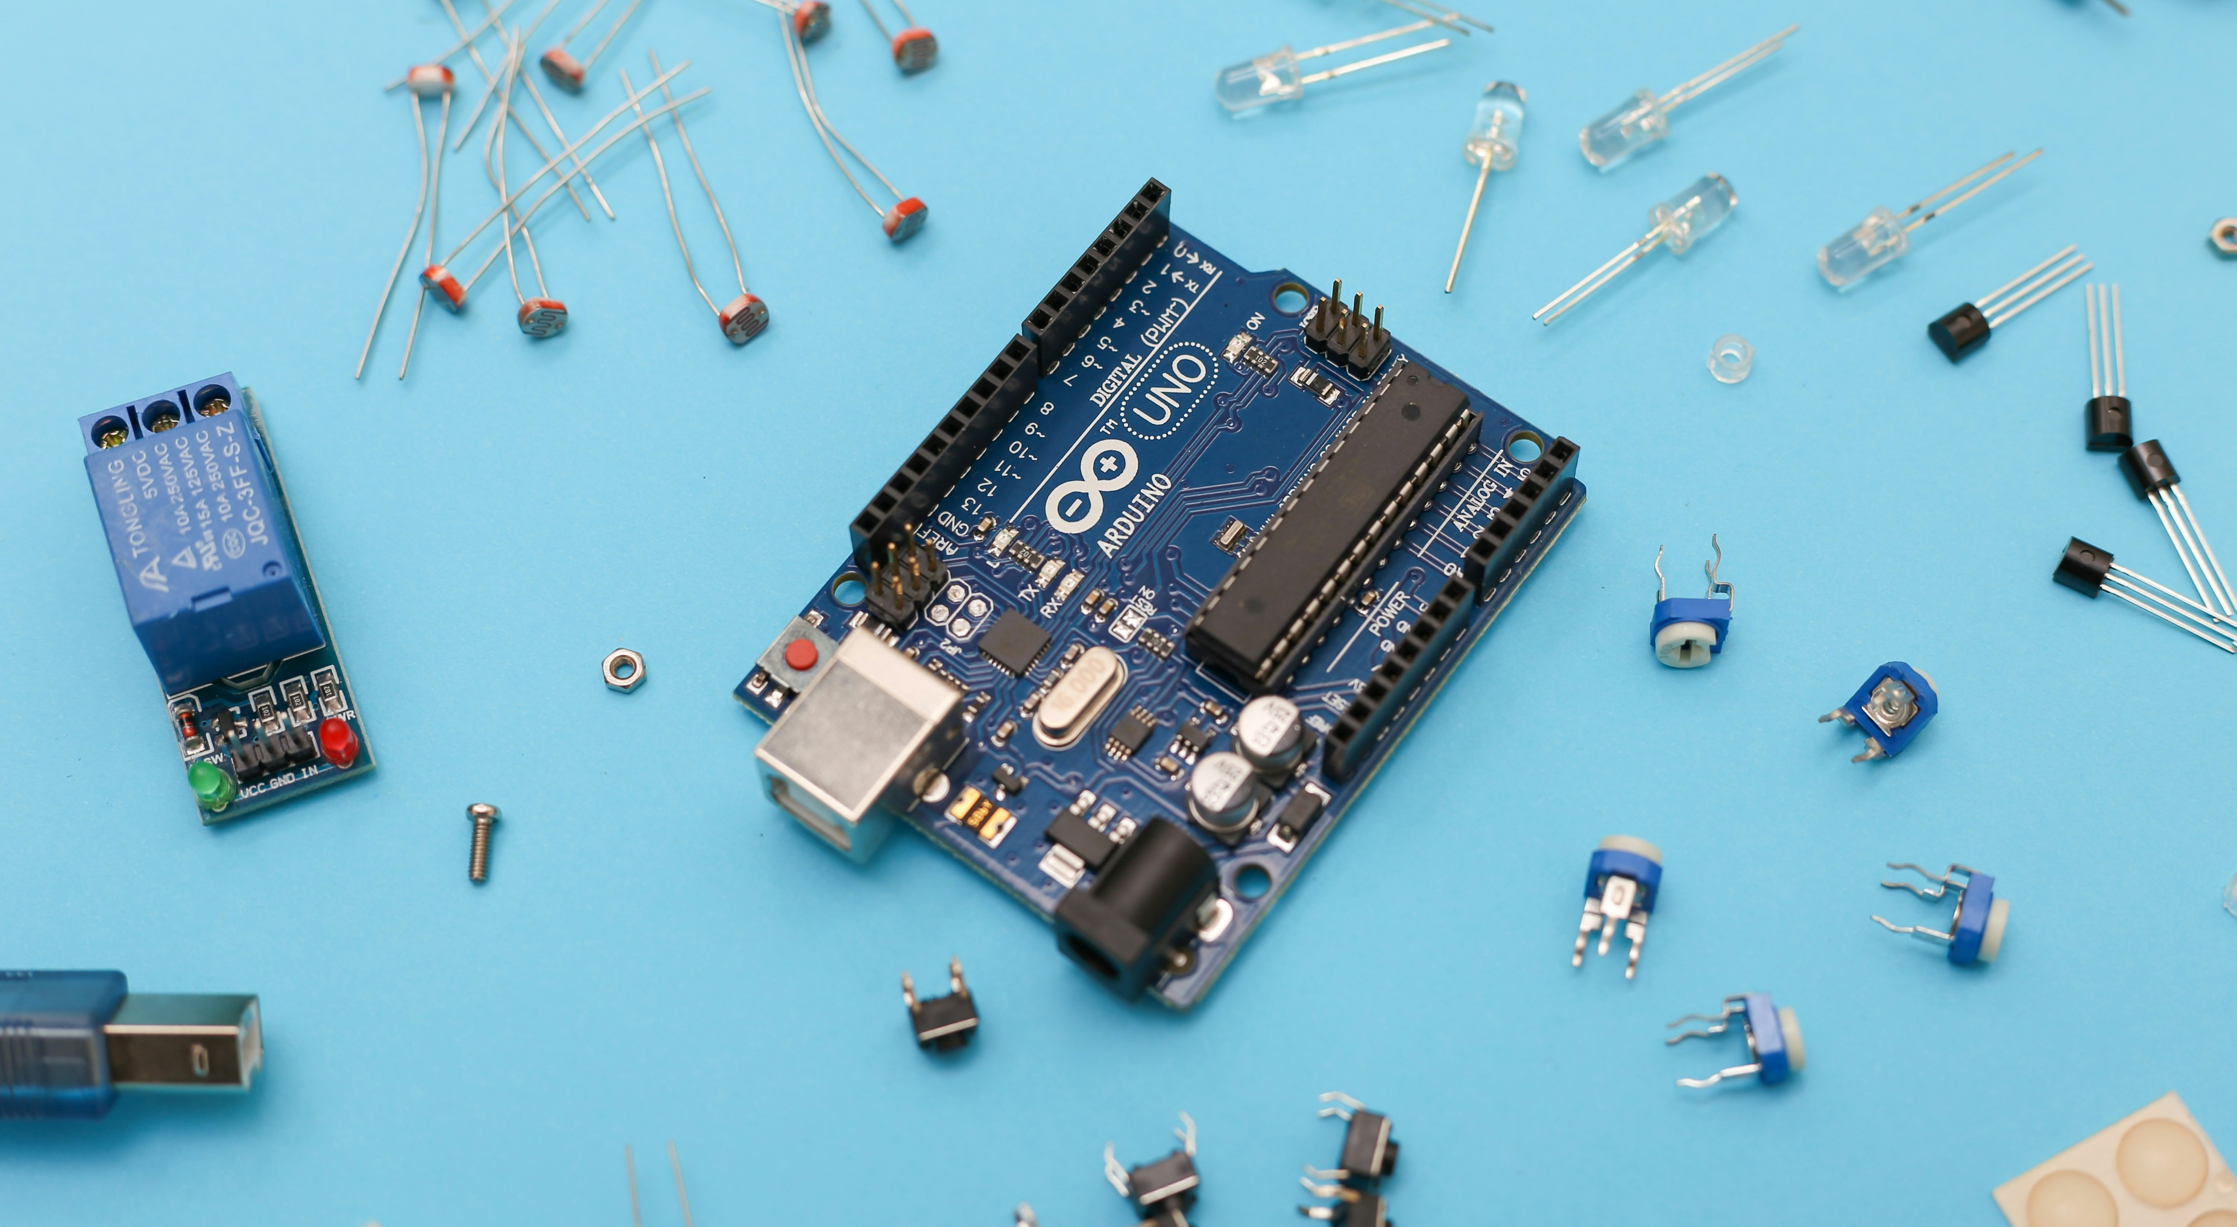

Lab Inventory Management API
Case Study : Intelligent Systems
Amritesh Vadakkedath Babu
Allan Johns
Anaz Nizarudeen Raseena Beevi
Asin Sona Thomas

Slide 2
Quick Recap
Objective
To enhance efficiency and accuracy in inventory tracking by implementing a robust Flask-based application.
Today’s focus
Progress update with a detailed discussion on API endpoints and their implementation.

Slide 3
Progress Overview
Completed Milestones:
Developed core routes for login, inventory management, and item updates.
HTML templates integrated with Flask routes for a seamless user experience.
Basic authentication implemented using.
CRUD operations for managing inventory items.
Ongoing Tasks:
Refining the UI for better usability.
Preparing Docker container for deployment.
Next Steps:
Deployment to the university server via Docker.

Slide 4
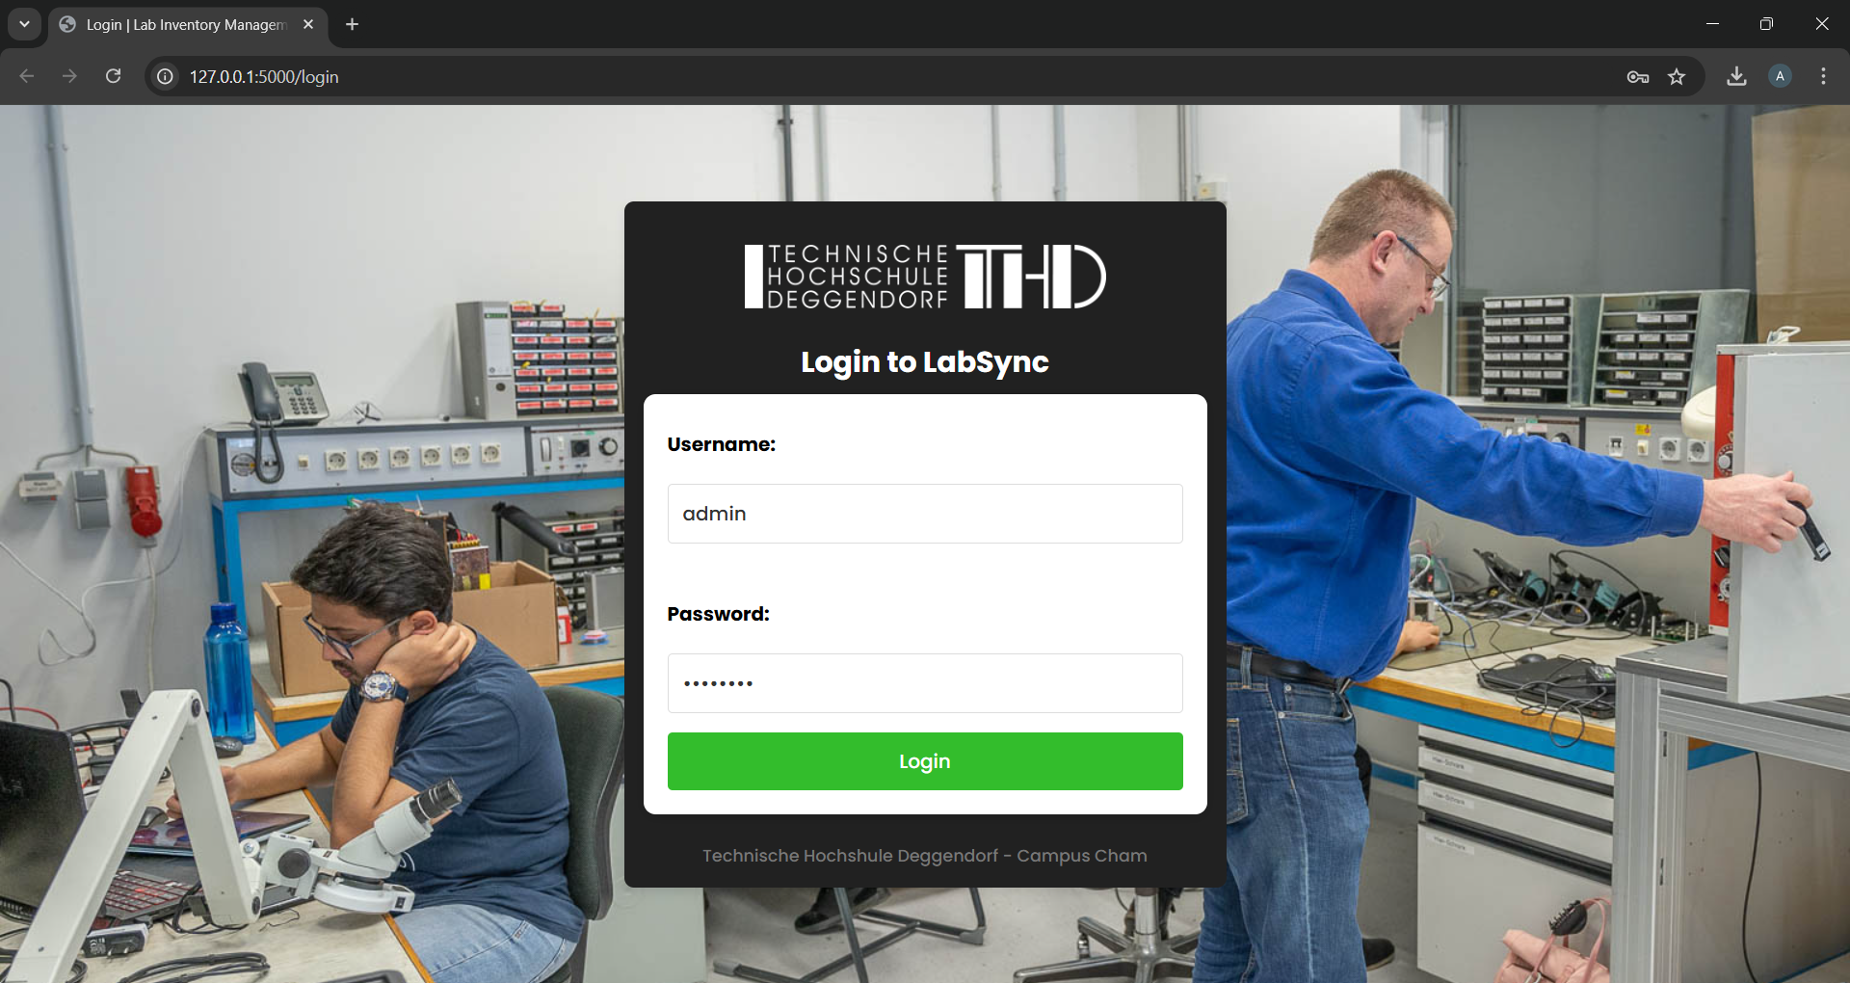
Key Routes Overview 1. /login
User Authentication
Accepts a username/password (hardcoded users for simplicity) and logs the user in.
Validates credentials and starts a session using Flask-login.

Slide 5
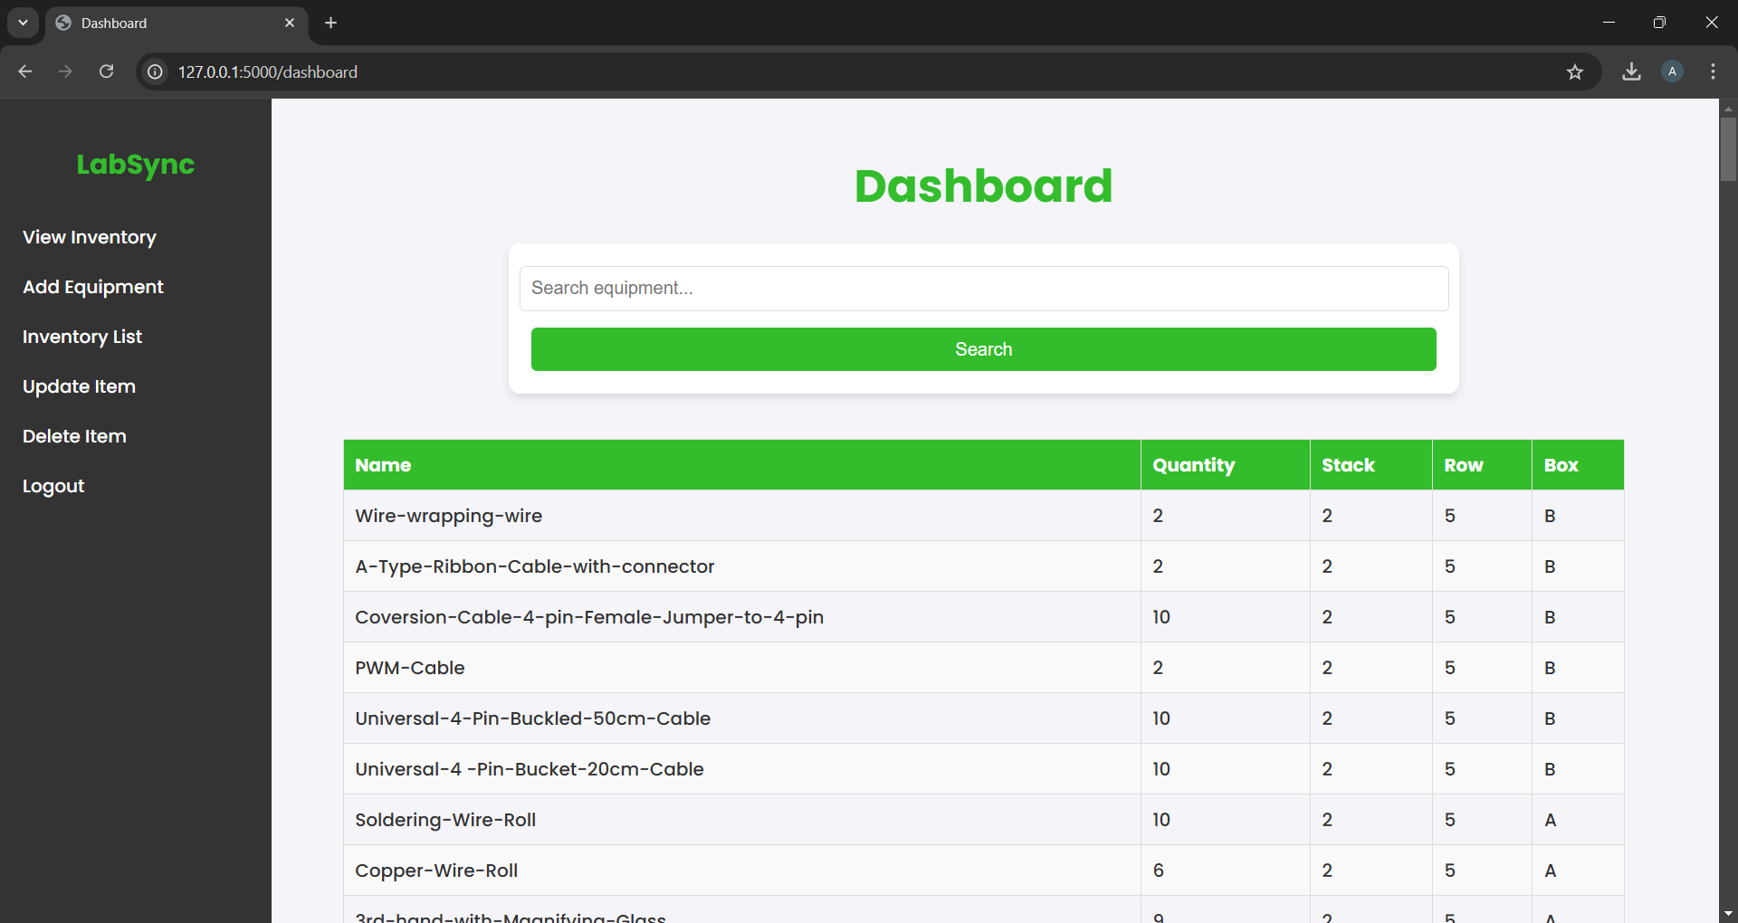
2. /dashboard
Central hub for managing and viewing inventory.
Displays a searchable, sortable, and paginated table of all inventory items.
Fetches items from the database, supports search queries, and orders results by most recently added.

Slide 6
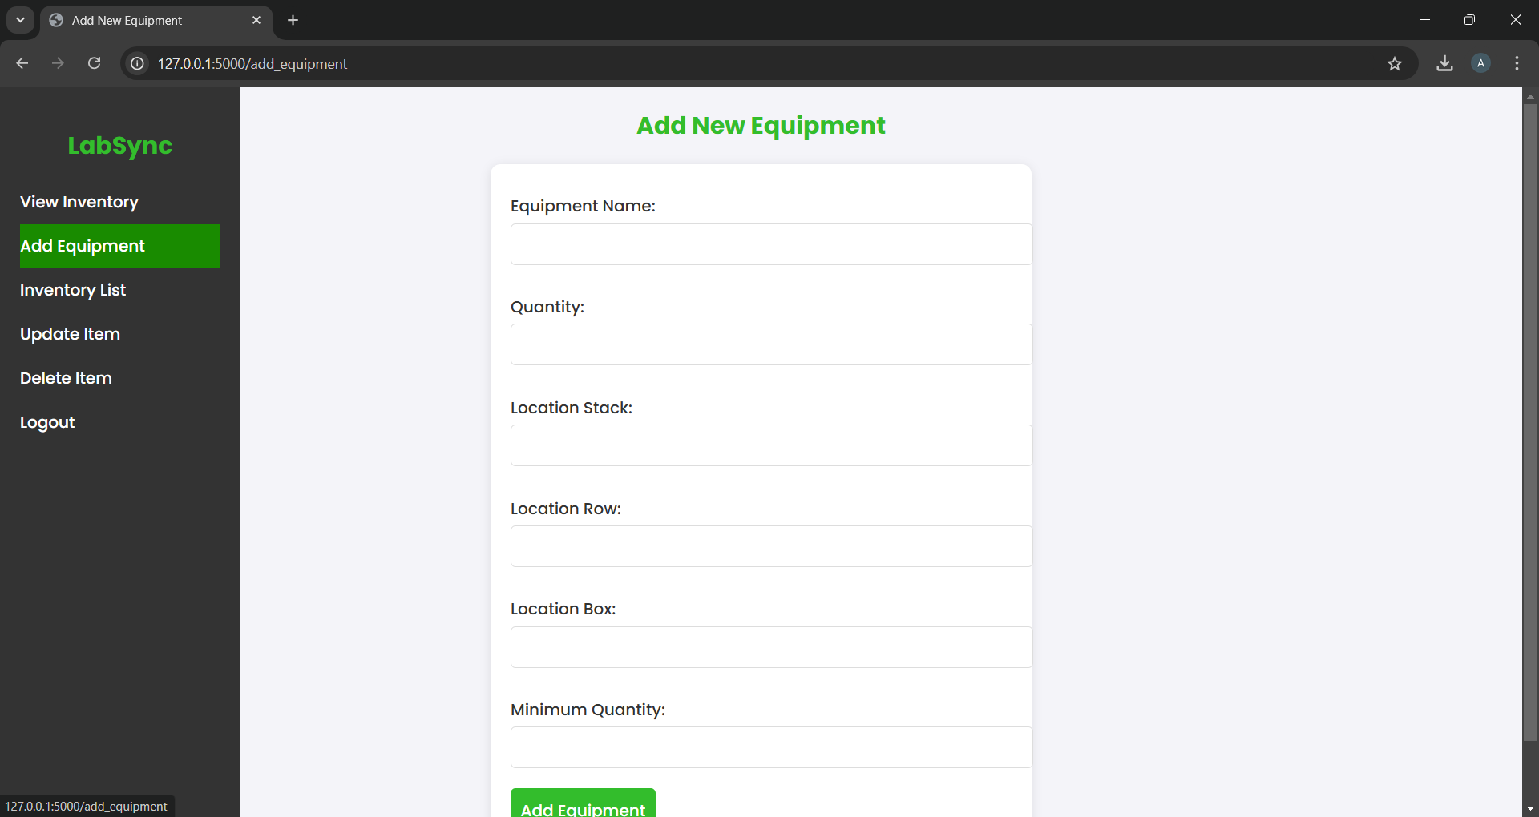
3. /add_equipment
Add new inventory items.
Provides a form for adding items with fields like name, quantity, location, and minimum quantity.
Inserts the item into the database and flashes a success message.

Slide 7
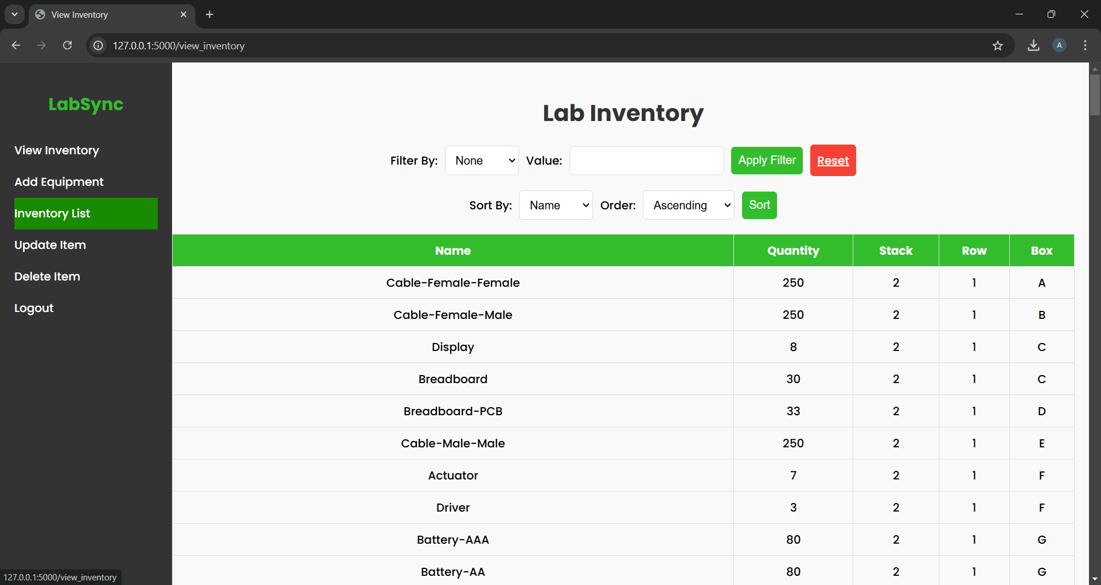
4. /view_inventory
View and filter inventory items.
Allows filtering and sorting by attributes like name, quantity, or location.
Dynamically fetches and displays filtered/sorted results.

Slide 8
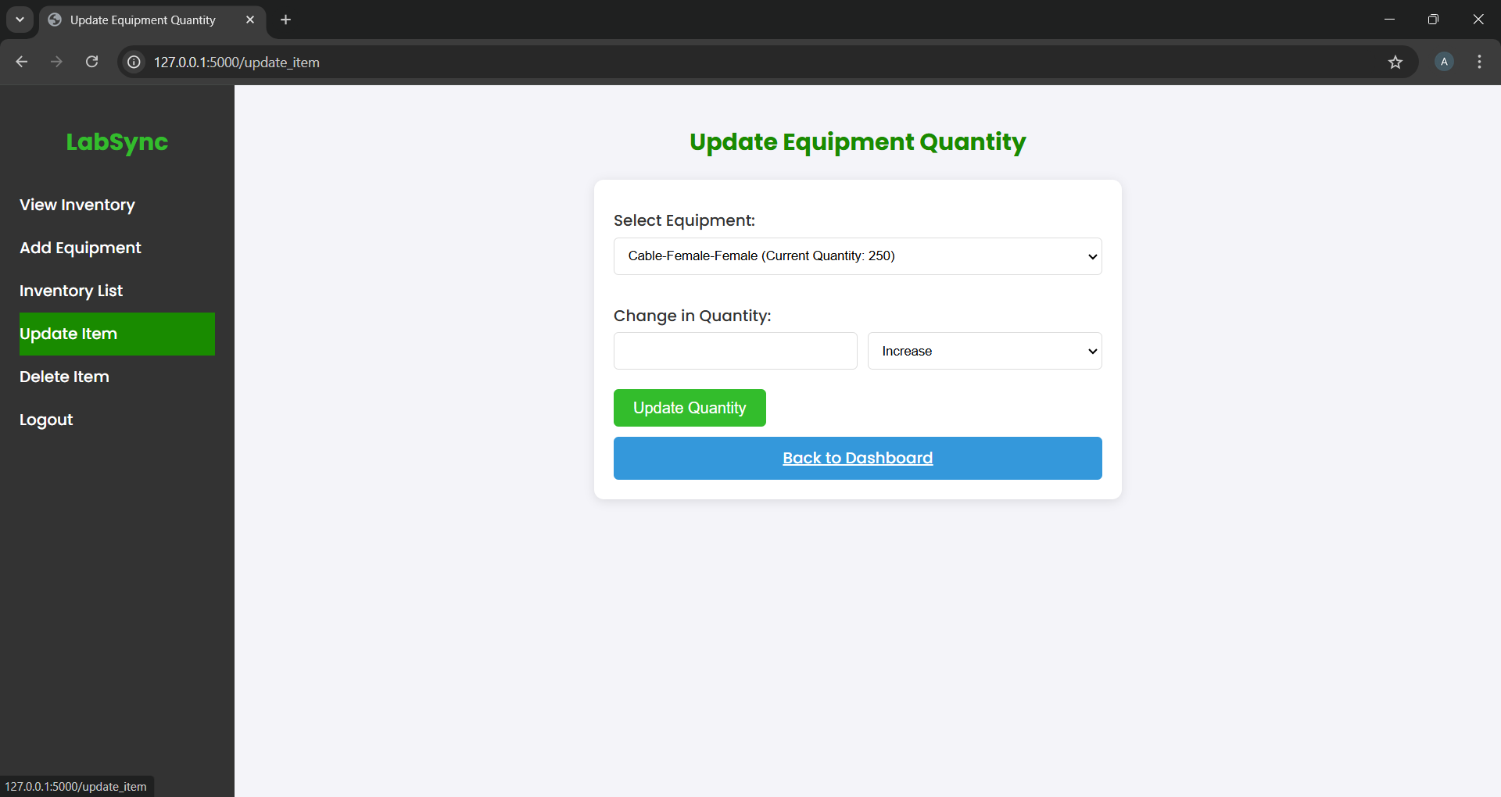
5. /update_item
Update the quantity of existing items.
Supports increasing or decreasing item quantities, with warnings for low stock
Updates item quantities in the database and flashes relevant messages.

Slide 9
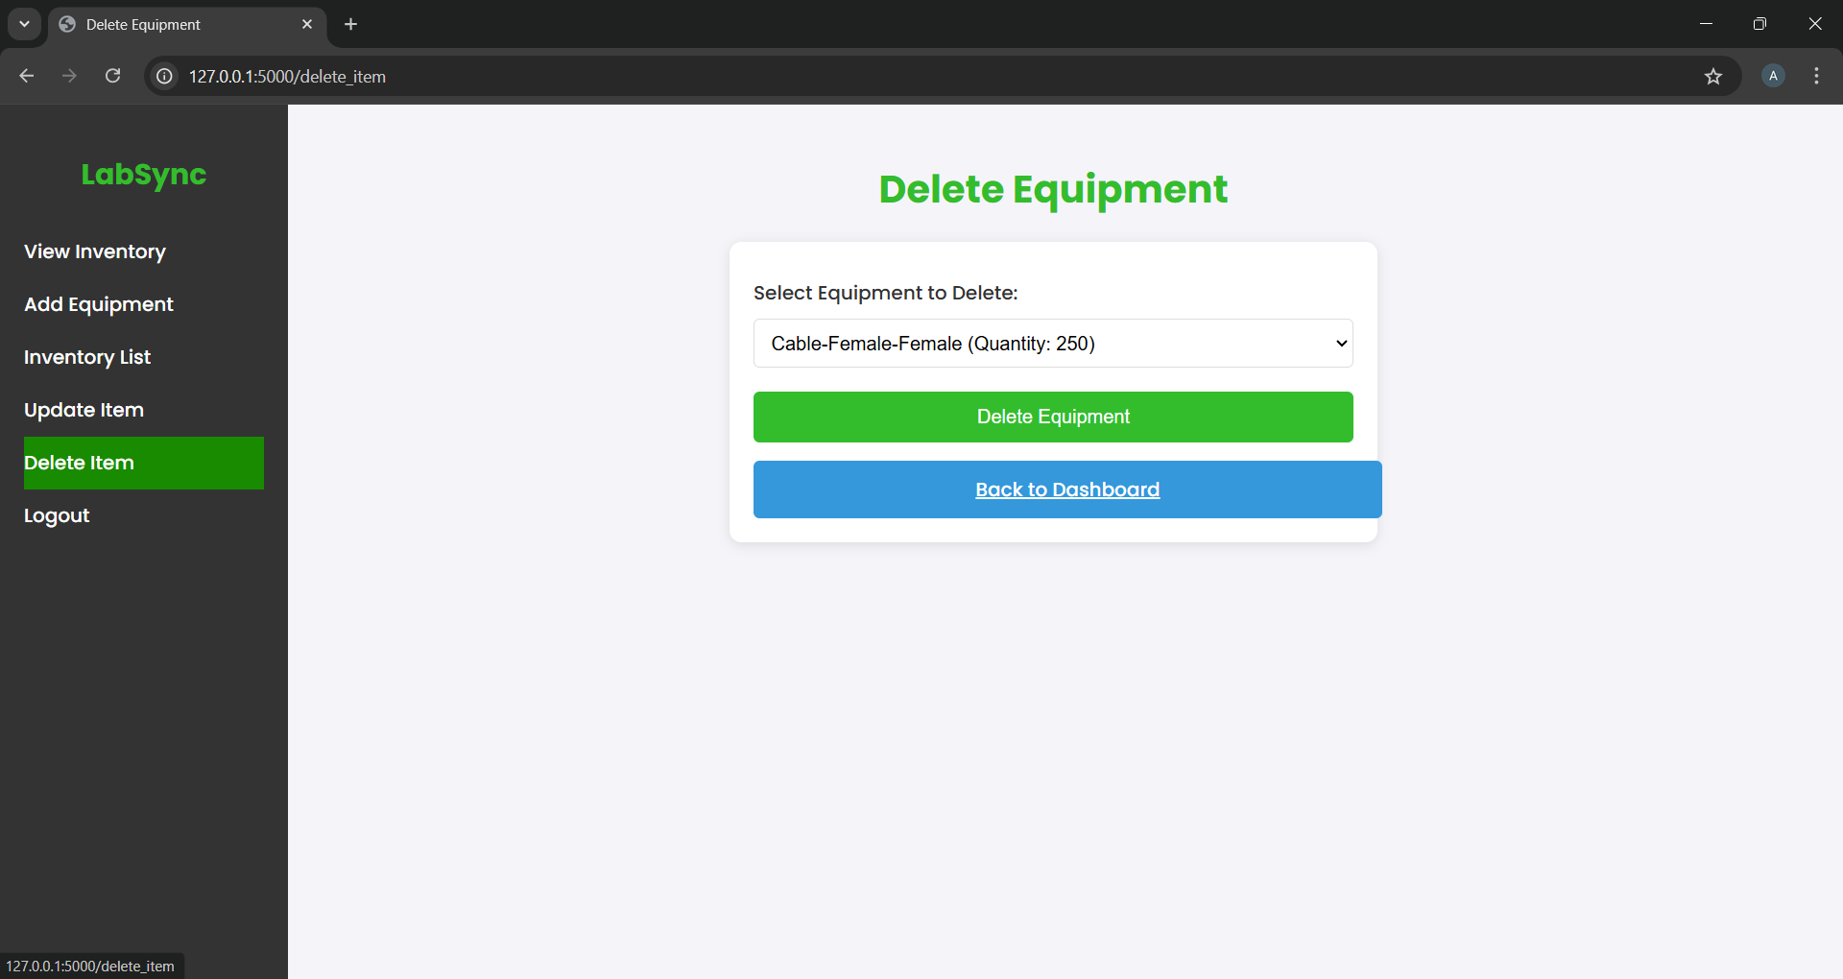
5. /delete_item
Delete inventory items.
Allows users to select and remove items from the database.
Deletes the selected item and flashes a success message.

Slide 10
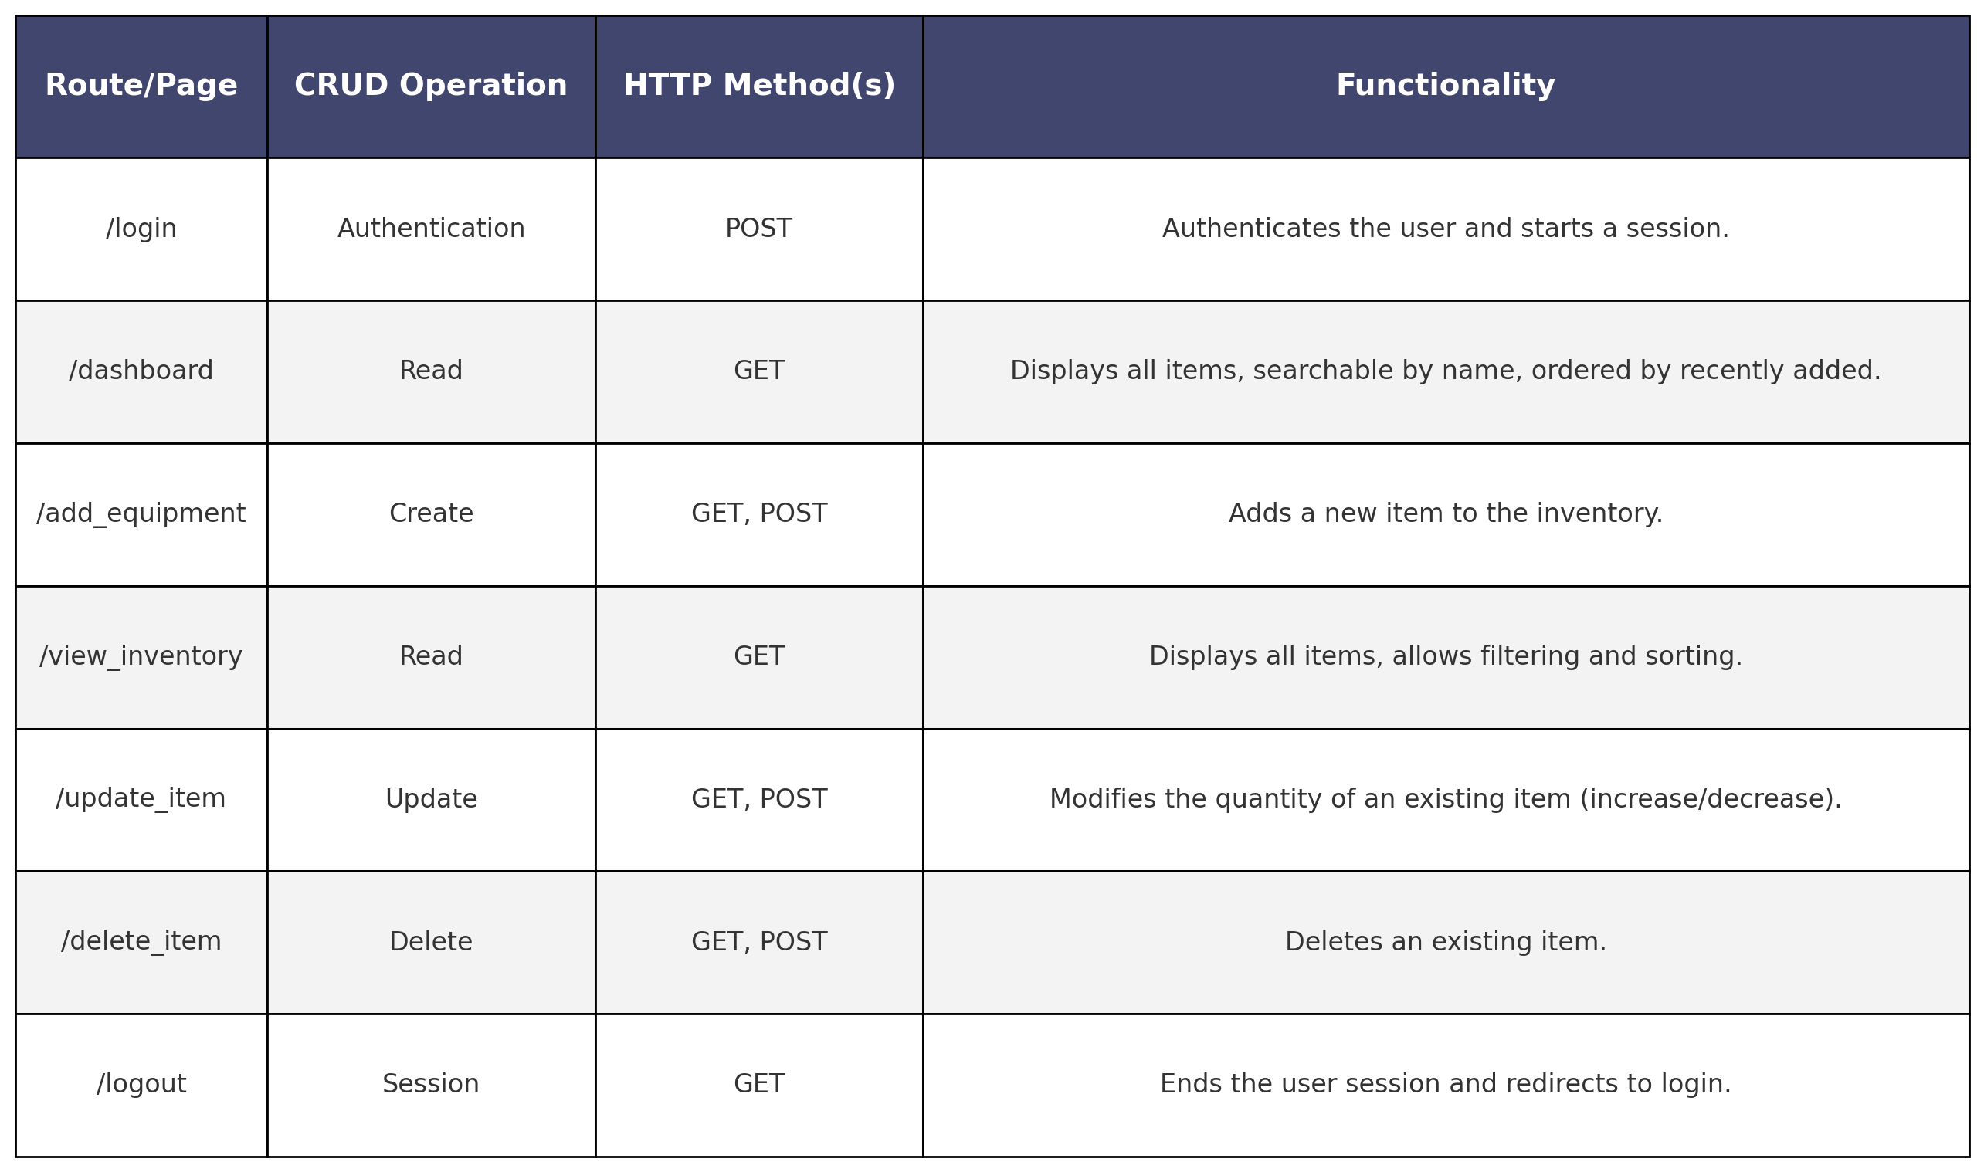
CRUD Summary

Slide 11

Next Steps
Remaining Tasks:
Refine frontend design for a cleaner and more intuitive UI.
Package the application in a Docker container.
Deploy to the university server for production use.
Future Enhancements:
Add a feature to upload an image of an equipment item, identify its name, and check if it exists in the inventory.
Integrate the system with e-commerce websites to suggest purchase options for items with low stock.

Slide 12

Questions .. ?

